Slide 1

PASSENGERS POSITIONING SYSTEM
PROJECT TITLE
PROJECT TASKS
REQUIREMENTS AND ANALYSIS

Slide 2
CONTENT
GROUP PRESENTATION
PROBLEM ANALYSIS
REQUIREMENTS
REQUIREMENT VERIFICATION AND VALIDATION.

Slide 3
GENERAL INTRODUCTION
SYSTEM OVERVIEW
PROBLEM STATEMENT
OBJECTIVES
User Friendly Mobile application
Accurate real-time public transport information
Driver-passenger Interactions
With the current increase in the price of fuel, taxi drivers lose a lot of profits wondering around areas with little or no customers. To remedy this situation, we propose a system that manages passengers and drivers so that both parties can easily find each other.

Slide 4
FUNCTIONAL REQUIREMENTS
01
02
03
USER REGISTRATION AND AUTHENTICATION
GPS POSITIONING
RIDE REQUEST
04
05
06
RIDE ACCEPTANCE
DRIVER MATCHING
TRACKING
SYSTEM REQUIREMENTS

Slide 5
FUNCTIONAL REQUIREMENTS
07
08
09
FARE CALCULATION
MESSAGING
REVIEWS AND RATINGS
10
MULTIPLE LANGUAGES

Slide 6
NON FUNCTIONAL REQUIREMENTS
01
02
03
ACCURACY
RELIABILITY
SCALABILITY
05
04
06
SAFETY AND SECURITY
ADAPTABILITY
USABILITY AND PERFORMANCE
SYSTEM REQUIREMENTS
07
MAINTAINABILITY

Slide 7
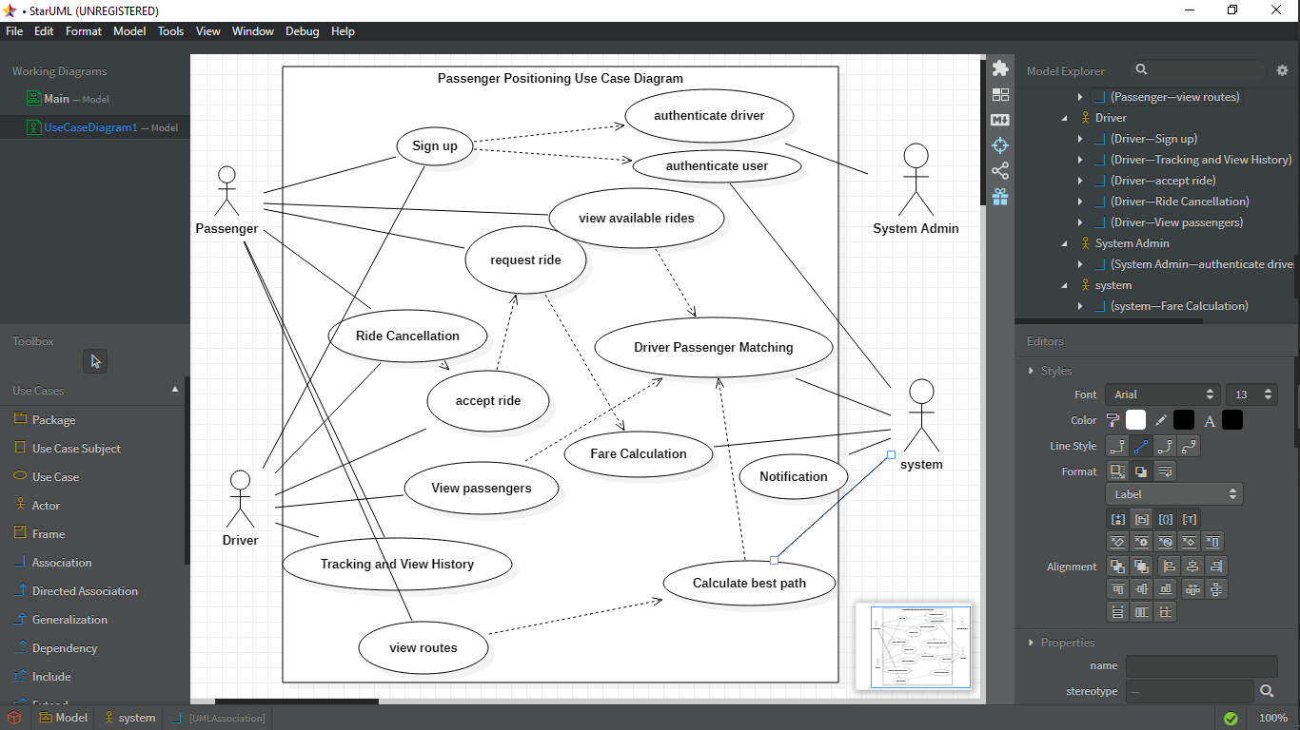
USE CASE DIAGRAM

Slide 8

TECHNOLOGY STACK
Programming Language and Framework
Dart And Flutter
Mobile App Development Platforms
ANDRIOD SDK, iOS SDK
Database
Firebase
Mapping And Location Services
Google API Or MapBox
Design
UI/UX
Branding
Visual Design
Testing
Functional Testing
Performance
Security

Slide 9

VERIFICATION AND VALIDATION OF REQUIREMENTS
Existing Systems Review
Market Research Mechanism
Results analysis

Slide 10
EXISTING SYSTEMS REVIEW
LOCAL APPLICATIONS
INTERNATIONAL APPLICATIONS
GOZEM APP
BEEGROUP
YANGO
ZGO
UBER
LYFT
GOJEK
CAREEM
OLA
VIA
BLABLA CAR
BRIDJ
GOKID
HITCH

Slide 11


SURVEYS AND INTERVIEWS
PHYSICAL INTERVIEWS
ONLINE SURVEYS
Online Interviews
Google Forms
Online Data exploitation
Local Taxi Drivers
Road Users
Transport Agencies
Driver Unions

Slide 12
RESULTS ANALYSIS
Other Apps Experience
How Important is real time ride information
Choice of features
Possible Turn-Offs

Slide 13

THANK
YOU!!!!!

